Slide 1


Amazon Web Services – Data Analytics
Glue – Serverless ETL Tool

Slide 2

By the end of this lesson, you will be able to:
Introduction to Data Warehouse
Introduction to Data Lake
Data Warehouse Vs Data Lake
ETL vs TLT
Introduction to AWS Glue
Glue Features
Glue Architecture
Glue Components
AGENDA

Slide 3
What is Data Warehouse
A data warehouse is a centralized repository that stores integrated data from multiple sources.
It is designed to support business intelligence (BI) activities, including querying, reporting, and data analysis.
Data Warehouse applications are designed to support the user ad-hoc data requirements, an activity recently dubbed online analytical processing (OLAP).
These include applications such as forecasting, profiling, summary reporting, and trend analysis.
Key features of Data Warehouses
1
2
3
4
Subject-oriented
Integrated
Time Variant
Non-Volatile

Slide 4







Data Warehouse Architecture
Data Sources
Staging Area
Warehouse
Users
Operational System
Metadata
Analytics
Operational System
Reporting
Raw Data
Summary Data
Flat Files
Mining

Slide 5
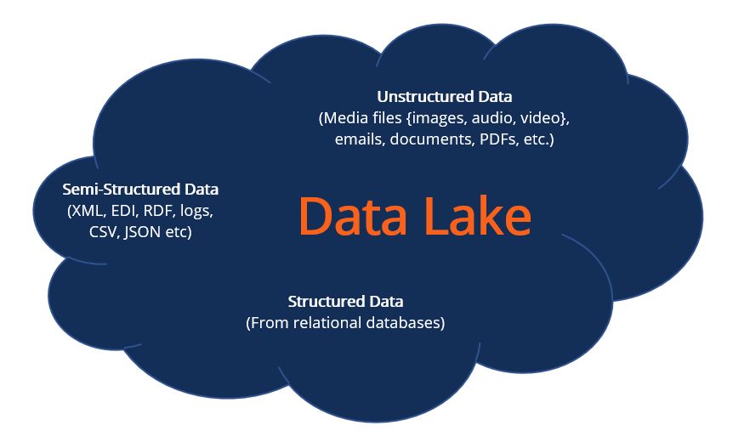
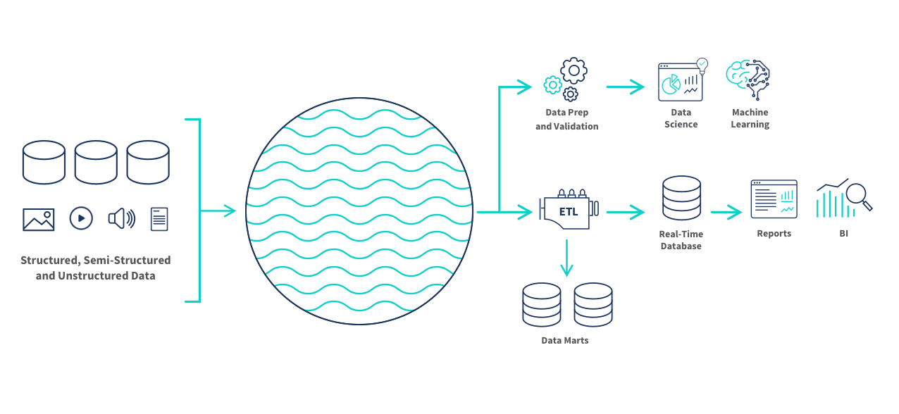
What is Data Lake
A data lake is a centralized repository designed to store, process, and secure large amounts of structured, semi structured, and unstructured data.
It can store data in its native format and process any variety of it, ignoring size limits.
You can store your data as-is, without having to first structure it, and run different types of analytics from dashboards and visualizations to big data processing, real-time analytics, and machine learning to guide better decision.
Data Lake Architecture

Slide 6
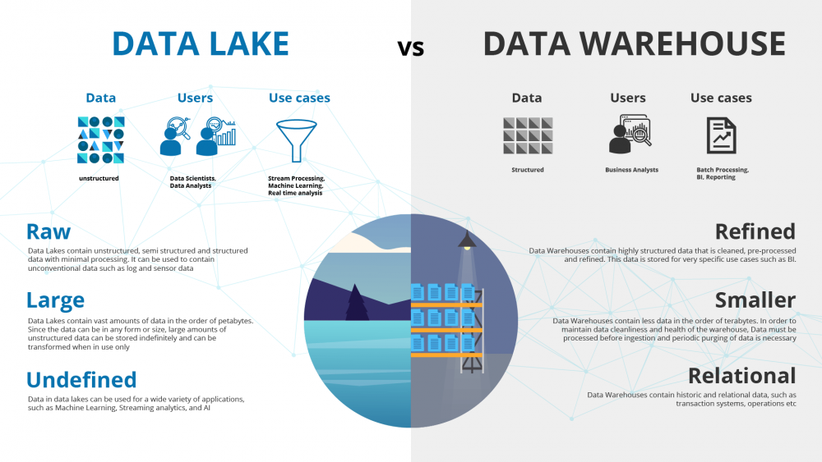
Data Warehouse vs Data Lake

Slide 7
Data Warehouse vs Data Lake
About | Data Warehouse | Data Lake
Data | Structured, Processed | structured/semi-structured/unstructured, raw
Processing | schema-on-write | schema on read
Storage | expensive | designed for low cost
Agility | less agile, fixed configuration | highly agile, configure & configure as needed
Security | mature | maturing
Users | business professionals | data scientists, etc

Slide 8
What Is ETL? - Data Warehouse
ETL stands for Extract, Transform, Load and it is a process used in data warehousing to extract data from various sources, transform it into a format suitable for loading into a data warehouse, and then load it into the warehouse.
The process of ETL can be broken down into the following three stages:
Extract
Transform
Load
The first stage in the ETL process is to extract data from various sources such as transactional systems, spreadsheets, and flat files. This step involves reading data from the source systems and storing it in a staging area.
In this stage, the extracted data is transformed into a format that is suitable for loading into the data warehouse. This may involve cleaning and validating the data, converting data types, combining data from multiple sources, and creating new data fields.
After the data is transformed, it is loaded into the data warehouse. This step involves creating the physical data structures and loading the data into the warehouse.

Slide 9
What Is ELT? - Data Lake
ELT stands for Extract, Load, Transform and it is a process used in data lakes to extract data from various sources, load it into a data warehouse and transform it into a format suitable.
The process of ETL can be broken down into the following three stages:
Extract
Load
Transform
The first stage in the ETL process is to extract data from various sources such as transactional systems, spreadsheets, and flat files. This step involves reading data from the source systems and storing it in a staging area.
After the data is transformed, it is loaded into the data warehouse. This step involves creating the physical data structures and loading the data into the warehouse.
In this stage, the extracted data is transformed into a format that is suitable for loading into the data warehouse. This may involve cleaning and validating the data, converting data types, combining data from multiple sources, and creating new data fields.

Slide 10
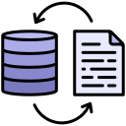


ETL vs ELT
Data Warehouse
ETL
ELT
Extract
Transform
Load
Data Lake
Extract
Load
Transform

Slide 11
What is Glue?
AWS Glue is a serverless data integration and ETL service that makes discovering, preparing, and combining data for data analysis, Machine Learning, and application development simple.
To enable the data integration process smoother, Glue offers both visual and code-based tools
Amazon Glue consists of three components namely, the AWS Glue Data Catalog, an ETL engine that creates Python or Scala code automatically, and a configurable scheduler that manages dependence resolutions, task monitoring, and restarts.

Slide 12
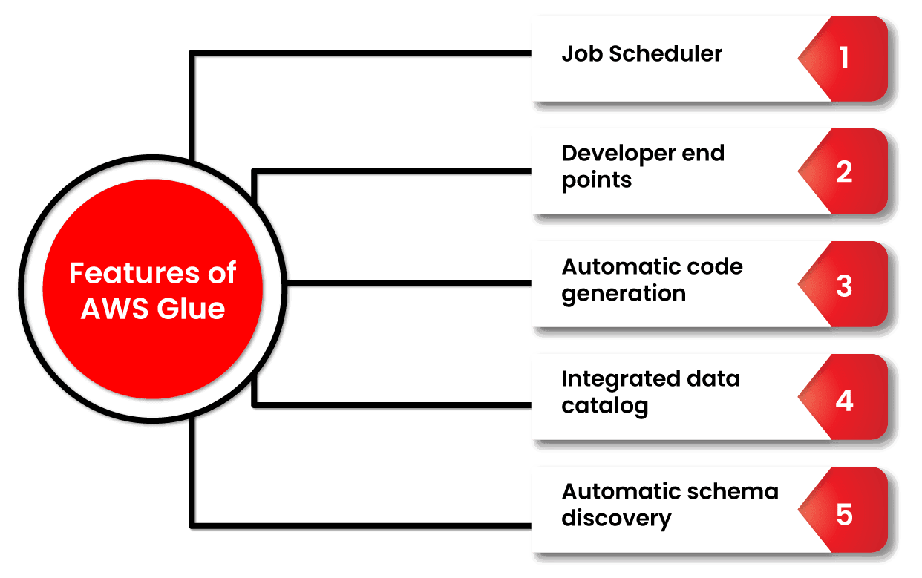
Glue features

Slide 13
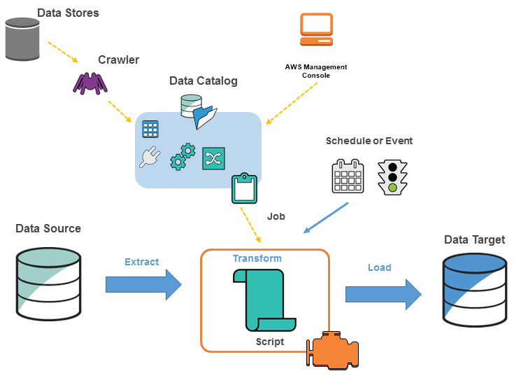
Glue Architecture

Slide 14
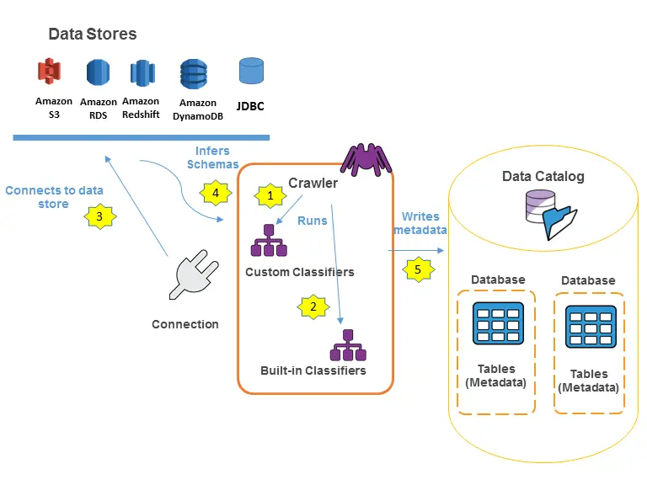
Glue Architecture (contd.)

Slide 15
Glue Components
AWS Glue Data Catalog: The Glue Data Catalog is where persistent metadata is saved. It delivers table, task, and other control data to keep your Glue environment running well. For each account in each location, AWS provides a single Glue Data Catalog.
Classifier: A classifier is a programme that determines the schema of your data. AWS Glue has classifiers for CSV, JSON, AVRO, XML, and other common relational database management systems and file types.
Connection: The AWS Glue Connection object is a Data Catalog object that contains the properties required to connect to a certain data storage.
Crawler: It’s a feature that explores many data repositories in a single session. It uses a prioritised collection of classifiers to establish the schema for your data and then builds metadata tables in the Glue Data Catalog.

Slide 16
Glue Components (contd.)
Database: A database is a structured collection of Data Catalog table definitions that are connected together.
Data Store: Data storage refers to a location where you can store your data for an extended period of time. Two examples are relational databases and Amazon S3 buckets.
Data Source: A data source is a set of data that is used as input to a transformation process.
Data Target: A data target is a storage location where the modified data is written by the task.
Transform: Transform is the logic in the code that is used to change the format of your data.

Slide 17
QUIZ Time!!
What is AWS Glue primarily used for?
Data Storage
Data Encryption
Data Integration
Data Visualization
Notes:
It’s Quiz Time!
Please read the question carefully and check all the options given. Pause the video for 10 seconds and answer the question.
Which of the following applications use AI?
Is it the gram (or the instagram)?
Or is it YouTube?
Is it the net banking application of your bank?
or is it the Anti-virus software installed in your computer or phone?
Which one of these leverage AI?

Slide 18

QUIZ Time!!
What is AWS Glue primarily used for?
Data Storage
Data Encryption
Data integration
data visualization
Notes:
It’s Quiz Time!
Please read the question carefully and check all the options given. Pause the video for 10 seconds and answer the question.
Which of the following applications use AI?
Is it the gram (or the instagram)?
Or is it YouTube?
Is it the net banking application of your bank?
or is it the Anti-virus software installed in your computer or phone?
Which one of these leverage AI?

Slide 19
QUIZ Time!!
Which programming languages does AWS Glue support for writing ETL scripts?
Python and Java
JavaScript and Ruby
Python and Scala
R and Julia
Notes:
It’s Quiz Time!
Please read the question carefully and check all the options given. Pause the video for 10 seconds and answer the question.
Which of the following applications use AI?
Is it the gram (or the instagram)?
Or is it YouTube?
Is it the net banking application of your bank?
or is it the Anti-virus software installed in your computer or phone?
Which one of these leverage AI?

Slide 20
QUIZ Time!!
Which programming languages does AWS Glue support for writing ETL scripts?
Python and Java
JavaScript and Ruby
Python and Scala
R and Julia
Notes:
It’s Quiz Time!
Please read the question carefully and check all the options given. Pause the video for 10 seconds and answer the question.
Which of the following applications use AI?
Is it the gram (or the instagram)?
Or is it YouTube?
Is it the net banking application of your bank?
or is it the Anti-virus software installed in your computer or phone?
Which one of these leverage AI?

Slide 21
QUIZ Time!!
In AWS Glue, what is a "crawler" used for?
Encrypting data in transit
Discovering and cataloging data
Visualizing data in dashboards
Monitoring application performance
Notes:
It’s Quiz Time!
Please read the question carefully and check all the options given. Pause the video for 10 seconds and answer the question.
Which of the following applications use AI?
Is it the gram (or the instagram)?
Or is it YouTube?
Is it the net banking application of your bank?
or is it the Anti-virus software installed in your computer or phone?
Which one of these leverage AI?

Slide 22
QUIZ Time!!
In AWS Glue, what is a "crawler" used for?
Encrypting data in transit
Discovering and cataloging data
Visualizing data in dashboards
Monitoring application performance
Notes:
It’s Quiz Time!
Please read the question carefully and check all the options given. Pause the video for 10 seconds and answer the question.
Which of the following applications use AI?
Is it the gram (or the instagram)?
Or is it YouTube?
Is it the net banking application of your bank?
or is it the Anti-virus software installed in your computer or phone?
Which one of these leverage AI?

Slide 23
QUIZ Time!!
What AWS Glue feature helps manage schema changes over time?
Glue Jobs
Glue Crawlers
Glue Data Catalog
Glue Triggers
Notes:
It’s Quiz Time!
Please read the question carefully and check all the options given. Pause the video for 10 seconds and answer the question.
Which of the following applications use AI?
Is it the gram (or the instagram)?
Or is it YouTube?
Is it the net banking application of your bank?
or is it the Anti-virus software installed in your computer or phone?
Which one of these leverage AI?

Slide 24
QUIZ Time!!
What AWS Glue feature helps manage schema changes over time?
Glue Jobs
Glue Crawlers
Glue Data Catalog
Glue Triggers
Notes:
It’s Quiz Time!
Please read the question carefully and check all the options given. Pause the video for 10 seconds and answer the question.
Which of the following applications use AI?
Is it the gram (or the instagram)?
Or is it YouTube?
Is it the net banking application of your bank?
or is it the Anti-virus software installed in your computer or phone?
Which one of these leverage AI?

Slide 25
QUIZ Time!!
Which AWS service is commonly used alongside AWS Glue to store raw data for ETL processes?
Amazon RDS
Amazon S3
Amazon Redshift
Amazon DynamoDB
Notes:
It’s Quiz Time!
Please read the question carefully and check all the options given. Pause the video for 10 seconds and answer the question.
Which of the following applications use AI?
Is it the gram (or the instagram)?
Or is it YouTube?
Is it the net banking application of your bank?
or is it the Anti-virus software installed in your computer or phone?
Which one of these leverage AI?

Slide 26
QUIZ Time!!
Which AWS service is commonly used alongside AWS Glue to store raw data for ETL processes?
Amazon RDS
Amazon S3
Amazon Redshift
Amazon DynamoDB
Notes:
It’s Quiz Time!
Please read the question carefully and check all the options given. Pause the video for 10 seconds and answer the question.
Which of the following applications use AI?
Is it the gram (or the instagram)?
Or is it YouTube?
Is it the net banking application of your bank?
or is it the Anti-virus software installed in your computer or phone?
Which one of these leverage AI?

Slide 27
Key takeaways
ETL Development
Data Integration
Real-world Use Cases
1
3
5
2
4
6
Glue Data Catalog
Job Scheduling and Orchestration
Glue and AWS Ecosystem

Slide 28
THANK YOU

